Slide 1
Chapter 8
Speaker: Kulan Kao
Date: 2006/3/20

Slide 2
Background
TCP (Transmission Control Protocol)
Reliable, flow control, congestion control.
Congestion window (cwnd)
  control and limit how many numbers of packet can be send to the Internet.

Slide 3
Background
TCP establishes a connection between sender and receiver before transmission.
Sender fragment data into several packets and transmit sequentially according to the id numbers of the packet.
TCP receiver will transmit back an ACK (acknowledgement) to sender when he receives a packet.
So sender can make sure that the packet was transmitted to receiver successfully.

Slide 4
Congestion Control Mechanisms of TCP
In order to prevent congestion resulted from transmitting too fast.
There are five stages in the congestion control mechanisms of TCP
  Slow-start
  Congestion avoidance
  Fast retransmission
  Fast recovery
  Timeout retransmission

Slide 5
Slow-start / congestion avoidance
ACK is used to provide reliable transmission.
Slow-start threshold (ssthresh) and cwnd are used to distinguish Slow-start from Congestion avoidance.
Slow-start phase
  Cwnd(t+t_{r})=cwnd(t)+1, if cwnd(t)<ssthresh
Congestion avoidance phase
  Cwnd(t+t_{r})=cwnd(t)+1/cwnd(t), if cwnd(t)>=ssthresh

Slide 6
Slow-start phase
Cwnd(t+t_{r})=cwnd(t)+1, if cwnd(t)<ssthresh
Congestion window increase 1 when sender receives an ACK.
As a consequence, congestion window doubles every RTT time.
Cwnd increase exponentially .

Slide 7
Congestion avoidance phase
If cwnd(t)>=ssthresh, Cwnd(t+t_{r})=cwnd(t)+1/cwnd(t)
Congestion window increase one segment every RTT time.
Cwnd increase linearly.
If packet loss or timeout is detected, TCP sender will set ssthresh to ½ of current cwnd size, and reset cwnd to 1, then retransmit the lost packet.

Slide 8
Acknowledgment
Sender uses ACK to make sure that packet was transmitted to receiver successfully.
The ACK send by receiver contains information about the sequence number of the received packet.
Sender will transmit a new packet when he receive ACK, this mechanism called ”self-clocking”.

Slide 9
Duplicate ACK
If receiver receives a new packet but its sequence id is not continuous to the last one, receiver will send an ACK with the sequence id of last packet, which is called “duplicate ACK”
TCP relies on this mechanism to provide reliable transmission.

Slide 10
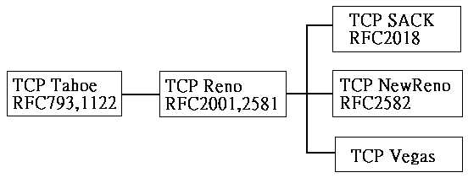
TCP Tahoe and TCP Reno
TCP
TCP Tahoe
  Slow-start, congestion avoidance, fast retransmit.
TCP Reno
  Slow-start, congestion avoidance, Fast recovery.

Slide 11
TCP Tahoe
Fast retransmit
  If sender receives 3 duplicate ACK, sender will assume the packet lost and retransmit this packet immediately.
  Then set ssthresh to ½ of current cwnd size, and reset cwnd to 1, back to slow start phase.

Slide 12
TCP Reno
Fast recovery
  Derived from fast retransmit.
  TCP Reno use fast retransmit to retransmit the lost packet, but not like TCP Tahoe who goes to slow start phase immediately, TCP Reno set ssthresh and cwnd both to ½ of current cwnd size.
  At this phase, if sender receives only 1 or 2 duplicate ACK, sender can still use self-clocking to transmit new packet and goes into congestion avoidance phase.

Slide 13
TCP Reno
Fast recovery
  Sometimes packet loss can be recovery without using timeout retransmit.
  This mechanism improve the usage of the link.

Slide 14
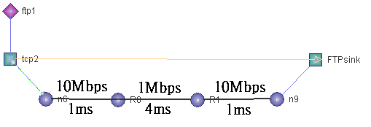
Exp8.tcl
Example 1
  Variation of TCP Tahoe congestion window.
Example 2
  Variation of TCP Reno congestion window

Slide 15
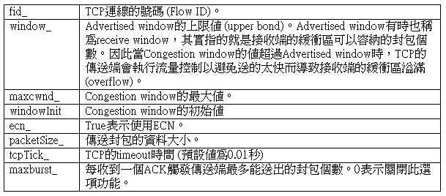
TCP sender parameter

Slide 16
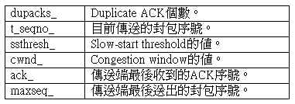
TCP sender parameter

Slide 17

TCP receiver parameter
TCP接收端的設定參數
TCP Vegas的個別參數

